Slide 1
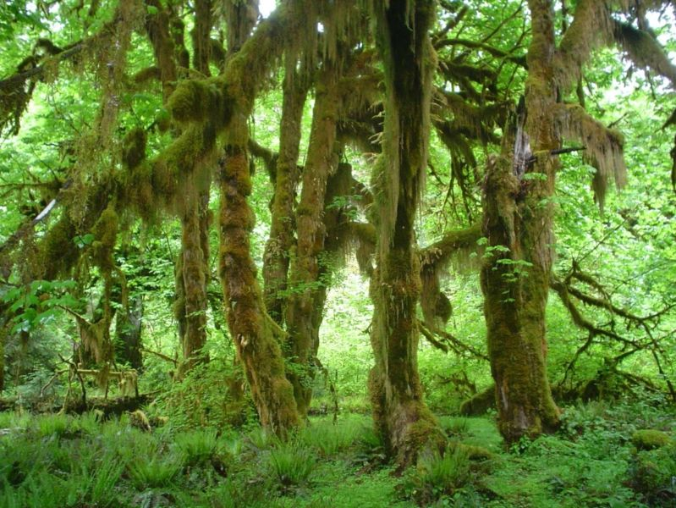
Ethics: Deep Ecology

Slide 2
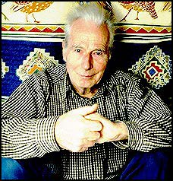
Arne Naess
Founder of Deep Ecology: biospheric egalitarianism
Coined term “deep ecology” in 1973
Deep ecology now has many, many adherents in philosophy, science, political activism and literature

Slide 3
Why “Deep”?
“Deep ecology” is deep because it questions fundamental assumptions in our philosophies and world view.
Attempts to deduce principles of action from basic values and premises.
Examples of “deep” questions:
What is an individual?
What things have intrinsic value and moral standing?
How should we understand nature?
What is the relationship between people and nature?
Deep ecology answers tend to be anti-individualist and anti-reductionist, and pro-holism.

Slide 4
Week Deep Ecology “Weak Ecology”
We need to protect the environment as a resource for humans.
We can do this by making minor changes in our lifestyle (Reduce, Reuse, Recycle).
Third world population growth is the main cause of environmental damage and must be stopped.

Slide 5
“Deep Ecology”
Humankind is not the only thing with intrinsic value. Deep ecologists often call themselves biocentrists – all living things are valuable.
Humankind needs to live in harmony with nature, not dominate it.
We must radically change our lifestyle, our view of what it means to be “rich,” which includes appreciation of cultural diversity and decentralization of social and political structures.
It is our extravagant lifestyle, and then its globalization that is the problem, not the just the population of third world nations.

Slide 6
Guiding Principles of Deep Ecology
Anti-anthropocentric
All life has inherent value – and equal value. Humans have no special moral status.
Richness and diversity of life are inherently good.
Individuals not as important as wholes: species, ecosystems, biodiversity, the earth.
The world would be better off with fewer people, and people should have less impact on the rest of nature.
We need to change our economic, technical and industrial systems, philosophical world view, and materialistic consumerist lifestyle.
We can’t rely on science to “fix” our current problems. Science can only treat the symptoms. We must try to cure the disease.
We can have a better life if we choose a life that is closer to nature and less materialistic. We would be better off and nature would be better off.

Slide 7
How is Deep Ecology “Deeper”?
Raises more probing questions, of a philosophical type, not just scientific or economic.
Calls for a more radical transformation of our lifestyles, toward much more simple living.
Calls into question government structures and social institutions.
Claims that these changes must be based on a realization of our unity or Oneness with all of life, all reality.
Attempts to draw on diverse religions and philosophies to support its case.

Slide 8
Deep Ecology: Some Key Principles
There is a metaphysical unity of all reality, even more fundamental than the unity of parts working together.
All of the system has equal inherent value (ecological egalitarianism). (But some make room for ‘vital interests’ one has for concerns close to them.)
Personal maturity involves the realization of unity through “Self-Realization” or “Identification” with all of reality.
Identification with all life will result in respect for the diversity of life and cultures, and will lead to radical changes in lifestyles, social institutions and political structures.

Slide 9
Dominant view
Dominance over nature
Natural environment as resources for human
Materialism
Economic growth for the purpose of self-demand
Earth “supplies” unlimited
High technological progress as solution for resources and waste
Consumerism
National/centralized community
Deep ecology
Harmony with nature
All nature has intrinsic worth/biospecies equality
Simple material need (for the purpose of self realization)
Earth “supplies” limited
Doing with enough/reuse/recycling
Social equality
Diversity

Slide 10
Criticism:
Founded on unjustified anthropomorphism: imbuing animals, plants, ecosystems, the earth, with human-like feelings and interests
Romanticizes nature as wise, harmonious, beautiful, good. But nature can be cruel, ugly, destructive.
Where does inherent value come from?
For something to have intrinsic rights or to deserve protection, it must have interests. How can plants or ecosystems have interests?
How could we, as humans, possibly understand the interests of other animals, plants, ecosystems, etc.
Inconsistent? There are no individuals, humans are merely a part of the whole, yet humans are uniquely responsible for environmental destruction.

Slide 11
Convergence
Although there are differing religious views of nature, and differing philosophical views of nature
There is a common implication of almost all of them: we need to take care of the world around us.
To do this, we must live less selfish, greedy lives, and recognize the value of that which is around us.
Recognize that we are intimately connected to the natural world.
Attempt to live more simply, with what we have rather than always wanting more. (Humans can be very greedy.)
Find ways to live in harmony with our natural home, interfering with natural processes as little as possible. (Humans have the capacity to be very destructive.)

Slide 12
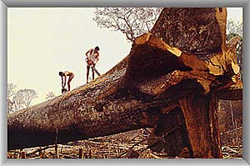

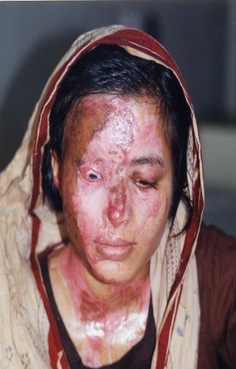
Ecofeminism
Rejects Patriarchal Dualisms
The domination of nature by men is wrong is similar to and related to the domination of women by men.
Must break the pattern of "power over" relationships will benefit both women and the natural world.
Acid attack victims

Slide 13
EcoFeminism: noticing domination based on difference
Sexism: male over female
Racism: white over black
Classism: wealthy over working class
Heterosexism: heterosexuals over GLBTQ
Ageism: adult youth over children & elders
Ableism: temporarily abled over differently abled
Speciesism: human over other animal species
Anthropocentrism: culture over nature

Slide 14
Basic Insights of Ecofeminism
Conceptions of nature and of women have been linked: earth as female, female as earthly/animal-like.
Devaluation and abuse of nature and women have gone hand in hand.
To overcome this problem, we must analyze and resist both together, and devise an ideal which liberates both.
Expansion often made: all oppressions (race, class, gender, environment) are linked and need to be fought together.

Slide 15
Nondualistic & nonhierarchical
Versus Patriarchy as dualistic & hierarchical
The world is fundamentally an interrelated web of relationships.
The world is fundamentally egalitarian rather than hierarchical.
Dualities and hierarchies are social constructions of patriarchy, not essential qualities of the world.

Slide 16
Ethics of care
Versus Patriarchy’s rationally determined justice
Ethics begins with our essential interrelatedness, not autonomy as individuals.
Our interrelatedness locates us in a situation of responsibility to others, naturally caring for them (as long as we are open to our connections).
Ethics are developed not by rationally determining justice but by deepening our awareness of our interrelatedness and extending our natural caring.

Slide 17
Versus Patriarchy’s notion of progress is domination over nature and other cultures in pursuit of material affluence.
The spread of patriarchal civilization is not true progress but rather the extension of the domination of those in power.
Individual and cultural diversity, like biodiversity, are the basis for cultural health and richness.
True progress comes from a multiplicity of individuals and cultures working in dialogue and cooperation.
The ideal is to empower diverse individuals and cultures and engage them in cultural, political, and environmental processes.

Slide 18
Feminism is not just about women.
It is about a new relationships

Slide 19
Ecofeminists standpoint
Connection between oppression of women and oppression of nature.
To understand this connection.
Solutions to ecological problems must include a feminist perspective.
Spiritual connection of women with earth-nature because of biological connections.

Slide 20
Ecofeminists look for nonviolent solutions to world problems. They consider feminine values necessary for survival in the conditions of the world's patriarchy.
And while ecofeminists may subscribe to liberal, radical, or Marxist/socialist thought, their main focus is on ecology - both of nature and human systems.

Slide 21
Ecofeminism: Patriarchal society interlocking pillars…sexism, racism, class exploitation and environmental destruction.
Deep connection between women & nature as reproducers & nurtures but socially created.

Slide 22
Women must see that there can be no liberation for them and no solution to the ecological crisis within a society whose fundamental model of relationships continues to be one of domination. They must unite the demands of the women’s movement with those of the ecological movement to envision a radical reshaping of the basic socioeconomic relations and the underlying values of this [modern industrial] society ( New Woman/New Earth, Ruether, 204).

Slide 23
In her Introduction to Ecofeminism: Women, Culture, Nature, editor Warren asserts: What makes ecofeminism distinct is its insistence that nonhuman nature and naturism (i.e., the unjustified domination of nature) are feminist issues. Ecofeminist philosophy extends familiar feminist critiques of socialisms of domination to nature .

Slide 24
In her essay “Development, Ecology and Women" Shiva: , Maldevelopment militates against this equality in diversity, and superimposes the ideologically constructed category of western technological man as a uniform measure of the worth of classes, cultures, and genders… Diversity, and unity and harmony in diversity, become epistemologically unattainable in the context of maldevelopment, which then becomes synonymous with women’s underdevelopment (increasing sexist domination), and nature’s depletion (deepening ecological crises)… .

Slide 25
Current Events
United Nations looking to punish those countries with emissions linked to global warming.
Current Issue- depleting the ozone layer with our extensive release of CO2 and fossil fuels.
Walking to locations instead of driving was done in the passed and we should continue to do so today.
We need to reduce our emissions of gases that harm the environment.

